Slide 1


By Nathaniel Rivera, Asim Razzaq, Joel Rodriguez

Slide 2
What is Go?
Go (or Golang) is a statically-typed, compiled programming language designed at Google to improve developer productivity in an era of multicore processors, networked machines, and large, complex codebases. Go was created by Robert Griesmer, Rob Pike and Ken Thomson in 2007. As Google’s infrastructure continued to grow, Google’s cloud engineers felt the large infrastructure was slowing down production. As a solution to this they created Go. Go was designed to improve readability, speed, security and ease of deployment compared to existing languages such as Java, C++ and Python.

Slide 3
History of Go
2007 - Google developers Robert Griesmer, Rob Pike and Ken Thomson begin developing a language to fix the issues they have with Google’s cloud infrastructure.
2009 - Go is officially launched by Google
2012: The release of Go 1.0 marks the first stable, production-ready version of the language.
2018 - Go introduces Go Modules system for dependency management
2022 - Generics were added to Go in Go1.18

Slide 4

The Features of Go
Statically-typed, compiled programming language
Clean easy syntax, while remaining reliable for higher level systems.
Automated memory management with built in garbage collection.
Provides multithreading and concurrency support built in as well as light weighted threads called goroutines.
Catches errors at compile time.
Supports high-performance networking
Can handle large-scale, distributed systems

Slide 5
The Structure of Go
Go is a structured language.
Go is not considered a functional language, logic language, or an object oriented language, but contains feature from both functional and object oriented languages.
While Go has objects and interfaces it does not have inheritance.
Go is a imperative language.

Slide 6
Formatting of Go
Similar to languages such as C and Java, lines in Go end in semicolons, however Go’s lexer can add them in for the user making them not required.
The types of Go are as follows, boolean, numeric, strings, arrays, slices, structs, pointers, functions, interfaces, maps and channels.
Loops are written similar to those in Java, but the parentheses are unnecessary in Go, such as, for int i = 0; i < 5 i ++ {}
To declare an Array in Go the following format is used, ArrayName = [Size]ElementType such as, Array = [5]String

Slide 7
IDEs
Go supports multiple IDEs, the following are those that are directly linked on Go’s official website.
Visual Studio Code
GoLand
Vim

Slide 8
Who It's For & Who Uses It
Go is primarily used by developers who are building backend systems, cloud infrastructure, and networking tools. It's not a general-purpose language like Python or Java for things like web front-ends or data analysis, but it excels in its niche.
The language is popular with:
DevOps and Site Reliability Engineers (SREs): Go is used for creating command-line tools, automation scripts, and monitoring systems.
Backend Developers: Go's concurrency features make it perfect for building APIs, microservices, and web services that handle heavy traffic.
Cloud Infrastructure Developers: Many of the fundamental tools of modern cloud computing are written in Go.

Slide 9

The Rise of Go during the Cloud Era
Go's growth in popularity coincided perfectly with the rise of modern cloud computing. Its design philosophy made it a natural fit for building the tools that would define this new era.
Docker: The containerization platform that has transformed software deployment was written in Go. Its simplicity and ability to create single, self-contained binaries were perfect for this use case.
Kubernetes: The container orchestration system, also born at Google, was built with Go. Its concurrency and networking capabilities were essential for managing large clusters of containers.
Terraform and Prometheus: Other essential tools in the DevOps and cloud-native landscape, such as the infrastructure-as-code tool Terraform and the monitoring system Prometheus, were also built using Go.
PayPal: The payment giant uses Go for its fraud detection and risk modeling systems, where low-latency and high-throughput are non-negotiable.
Go went from an internal Google project to “THE” language for cloud infrastructure, cementing its place as a modern, high-performance tool for a new generation of software development.

Slide 10

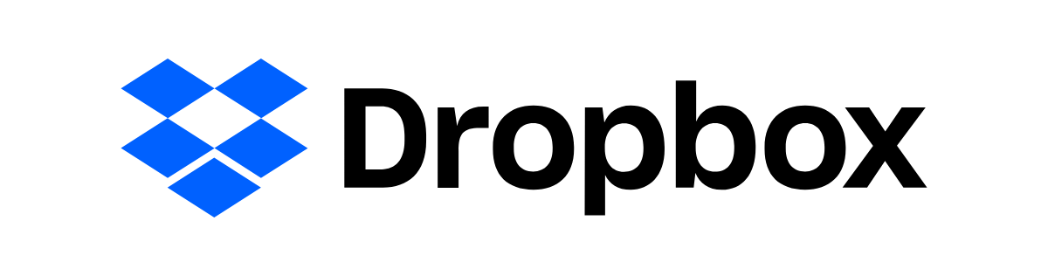




Major parts of infrastructure consists of Go
GPU-power analytics engine in Go
Business systems
For payments and rewards
Game development and operations
Backend Operations
Companies that currently use Go

Slide 11

Why should you learn
High Demand: Go developers are in high demand, particularly in the cloud computing and backend development spaces. Companies like Google, Uber, and Twitch rely on Go for their core infrastructure, which creates a steady stream of job opportunities.
Competitive Compensation: Due to the high demand and the specialized nature of Go's applications, Go developers are among the highest-paid in the industry.
Cloud-Native Development: Go is considered the "language of the cloud." Many of the fundamental tools of modern cloud computing—like Docker and Kubernetes—are written in Go. If you want a career in DevOps, cloud infrastructure, or backend services, Go is an essential language to know.
The Future: Go is an evolving language with a bright future. Upcoming versions and community development are focused on improving areas like generics and error handling, making it even more powerful and versatile. It's also gaining traction in emerging fields like machine learning and IoT.
?

Slide 12
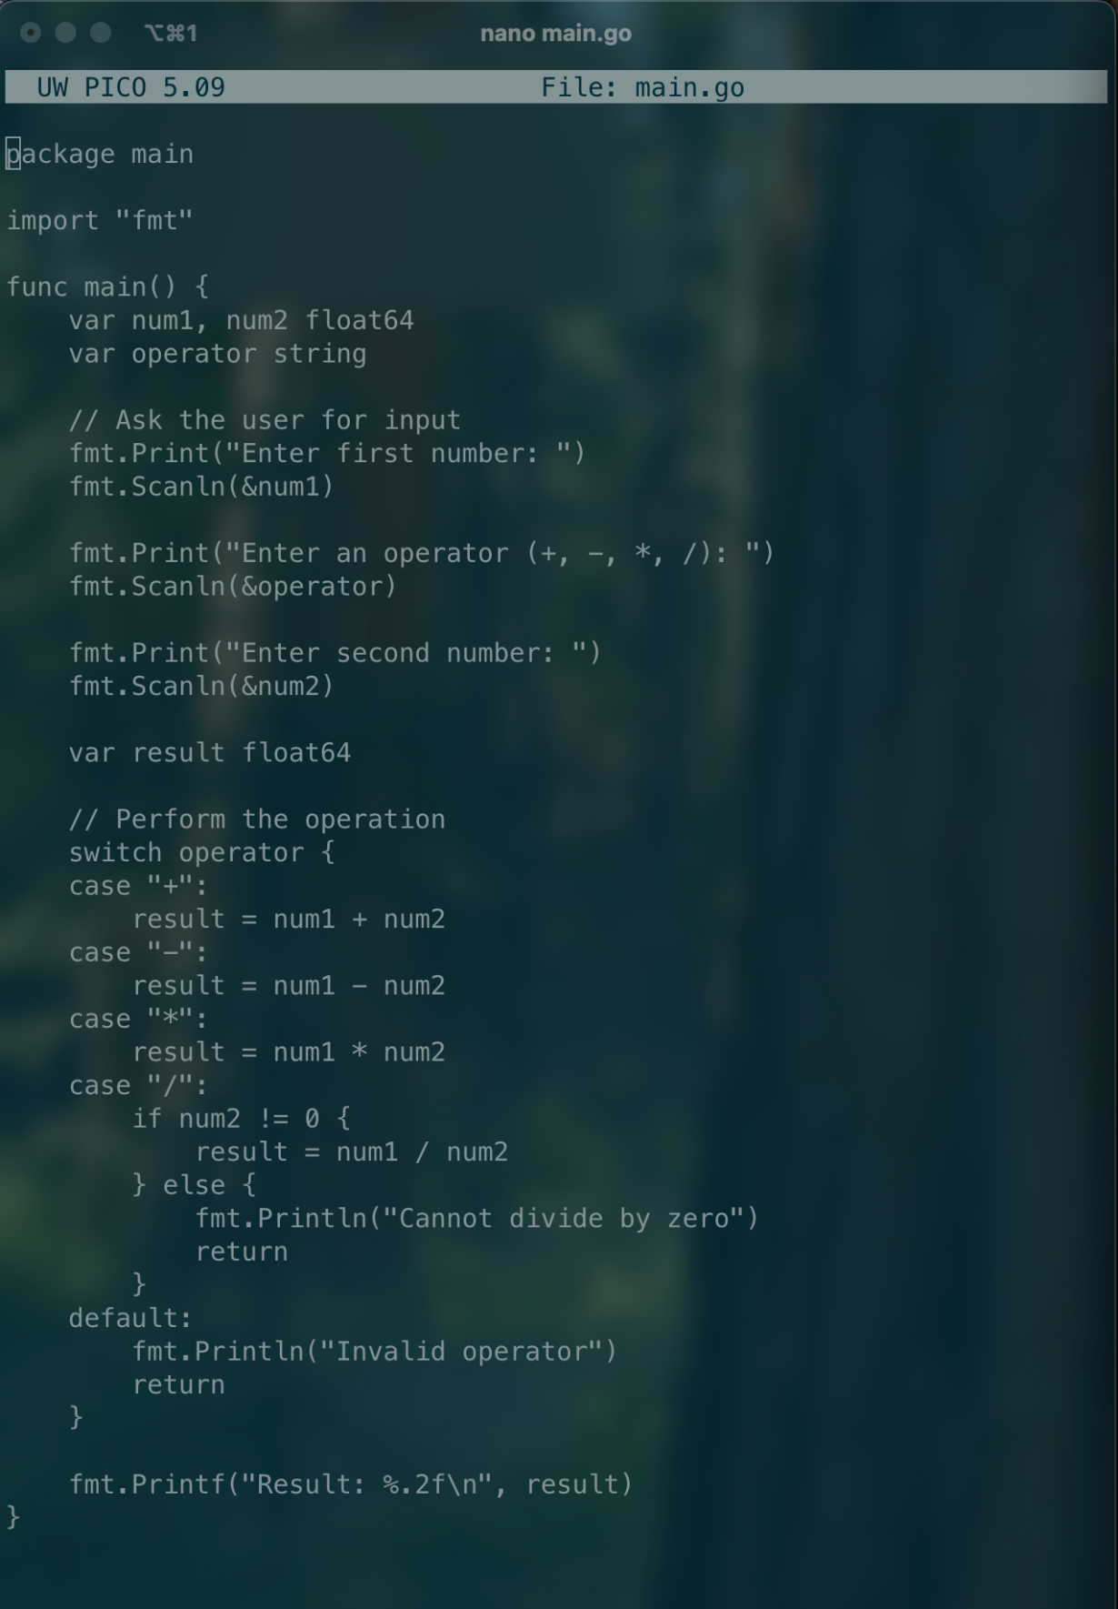
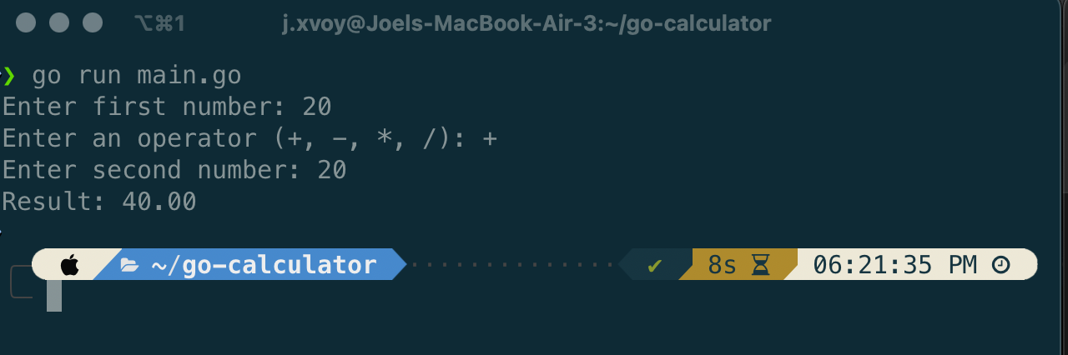
4 Operator Calculator

Slide 13
Thanks for Listening

